Slide 1

Building an Efficient ETL Pipeline for Property Records in Real Estate using PostgresSQL Database for Zipco Real Estate Agency
Data Engineering Consultant:
Adedamola Oyetayo

Slide 2
Business Problems:
Business Overview & Problems
➢ Business Name: Zipco 1. Industry: Real Estate Agency
2. success is driven by a deep understanding of consumer behaviour, effective marketing strategies, and a commitment to exceptional customer service.
At Zipco Real Estate Agency, the following pressing challenges were encountered within the data processing:
Inefficient Data Processing Workflow:
Disparate Datasets and Inconsistent Formats:
Compromised Data Quality
The current data processing system is cumbersome and inefficient, leading to delays in accessing critical property information
This disorganisation complicates data analysis and reporting, making it challenging for agents to derive actionable insights and for management to make informed strategic decisions.
The lack of a streamlined data management process lead to compromised data quality, including inaccuracies and outdated information.

Slide 3
Business Objectives & Stack Tools Used
➢ Objectives/ Aims: 1. Real-time Data Collection – Define goals and address challenges in data acquisition.
2. Efficient Data Processing – Evaluate data quality and ensure effective data handling.
3. Data Storage – Manage missing data, outliers, and perform necessary transformations.
4. Scalability – Implement and train predictive models for pricing optimization.
➢Tools:
1. GitHub – Version control and collaboration.
2. PostgresQL: a Relational database to store and manage data files during the ETL process
3. Python – Data analysis, visualization, and machine learning.
4. VS Code/Jupyter notebook – Development and collaboration environment.
5. Tableau: Visualizes data insights and trends, providing dashboards and analytics for stakeholders.
6. Draw.io: Used to design architecture for data processing and entity diagram for data modelling.

Slide 4
System Architecture

Slide 5

Quick Project Code walkthrough

Slide 6
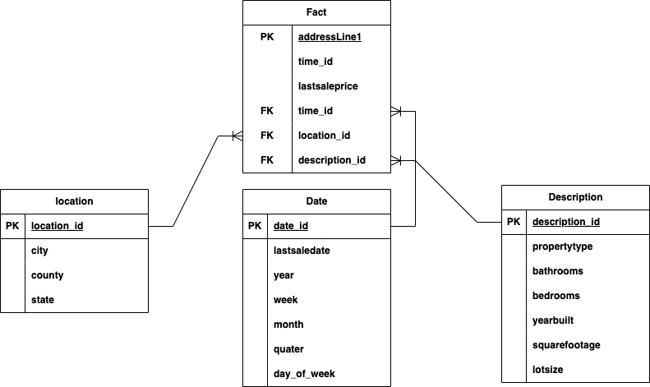
Zipco Data Modeling

Slide 7

Data Pipeline Automation using Crontab

Slide 8
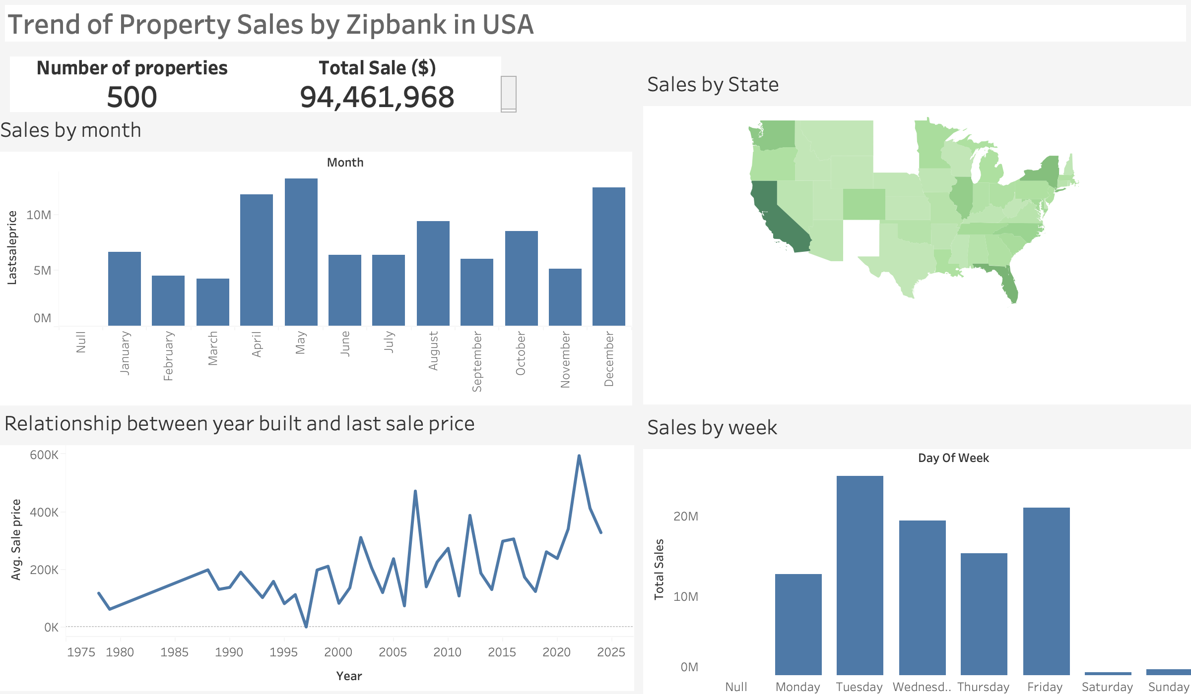
Dashboard

Slide 9
Conclusion: Transforming Data Management at Zipco Real Estate Agency
➢ Implemented a robust ETL pipeline that significantly reduced manual workflows, saving time and resources.
➢ Improved Data Quality: Ensured consistent, accurate, and reliable datasets to support decision-making.
➢ Enhanced Decision-Making: Delivered timely access to critical property and market insights, enabling better strategies and client satisfaction.
➢ Cost Efficiency: Automated processes minimized operational costs, allowing for resource reallocation towards growth initiatives.
➢ Scalable and Future-Ready: Built a secure and scalable system equipped to handle increasing data volumes while maintaining high performance.
➢ Competitive Advantage: Empowered Zipco Real Estate Operation

